Slide 1
Understanding
Elixir: A Programming Language
By: Dhruv Rana

Slide 2

What is Elixir?
Elixir is a dynamic functional programming language built upon the Erlang VM (BEAM)
Elixir is known for its high concurrency, low latency, and scalability for building connective systems.
Web Development
Embedded Software
Telecommunication
Multimedia

Slide 3

WHO & WHY?
Created by José Valim in 2012 when he was on the Ruby on Rails Core team.
Issue with improving performance on Rails
Lack of concurrency tools

Slide 4
Compiler
Elixir code can be run on the Elixir Idle Shell (iex).
iex to open Elixir shell
Compile with elixirc
samp.exs
Complies the code into Erlang bytecode.
Access to Erlang’s Libraries.

Slide 5

Default Environment
Kernel is Elixir’s default environment
Basic blocks of the language
Kernel.SpecialForms
Cannot be overridden
Invoke kernel functions without using the keyword kernel
You can opt out of kernel functions using except

Slide 6
Syntax - Identifiers and Reserved Words
Reserved words:
true, false, nil, when, and, or, not, in, fn, do, end, catch, rescue, after, and else
Identifiers:
Start with a lowercase or underscore; no uppercase, numbers or other special characters
Have any sequence of characters
snake_case

Slide 7
Syntax - Variable Declaration
Dynamically typed
‘=’ is not assignment
Binding the value to the variable
Pattern matching
Immutable

Slide 8
Data Types
Numerical types
Integers
Can use underscore for visuals. Ex: 1_000_000
Binary, octal, and hexadecimal forms
Floats
0.123
12.3e10

Slide 9

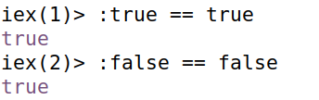
Data Types - Atoms
Atoms
Named constants whose value is their name
Created using a colon (:) character, followed by alphanumeric characters or underscores
Booleans
No dedicated boolean type; :true and :false are atoms
A boolean is an atom with the value of true or false.

Slide 10
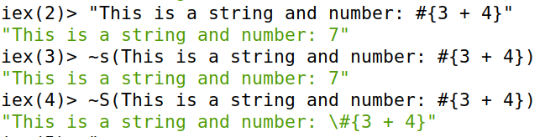
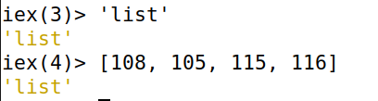
Strings
No dedicated string type
Represented using binary or lists
Another syntax for declaring strings using sigils: ~s
Character Lists:
List of integers where each value represents a character
Not compatible with binary strings
No string module operations
Concatenate strings using: <>
Character List:
Binary:

Slide 11
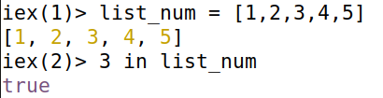
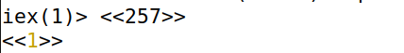

Lists, Tuples, and Binaries
Lists: used to store a collection of data
Can perform operations on lists and manipulate data
Tuples: used to group a fixed number of elements together
Ex: Group a pet’s name to its age
Binaries: used to specify size of each value and tell the compiler how many bits to use for the value
If the byte value provided is bigger than 255, the value is truncated to the byte size
Lists Tuples Binaries

Slide 12
Operators
Mathematical Operators: +, -, *, /, div, rem
Logical Operators: and (&&), or (||), and not (!)
Comparison Operators:
Difference between == and === is when you compare integers and float
===, !== | Strict equality, inequality
==, != | Weak equality, inequality
<, >, <=, >= | Less than, greater than, less than or equal, greater than or equal

Slide 13

Printing onto Screen
Printing statements is done through built-in modules and functions.
IO module can be used to perform various I/O functions.
The puts function in the IO module prints onto the screen.

Slide 14
Modules and Functions
Built in modules and functions
User defined modules
Alphanumeric characters, underscores, and the dot character
CamelCase
Functions
Defined within a module
Same naming convention as variables
Can end ? and !
Must refer to module name when called
defmodule Module1 do
def function(a, b) do
…
end
end
defmodule Module2 do
...
end

Slide 15
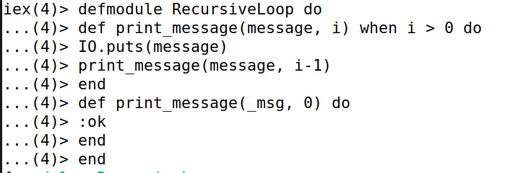
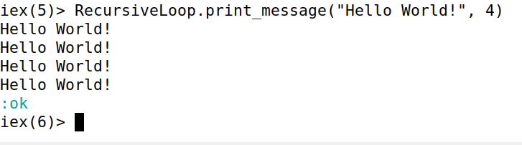
Loops
Recursive loops
Immutable data
No for-loops and while-loops

Slide 16
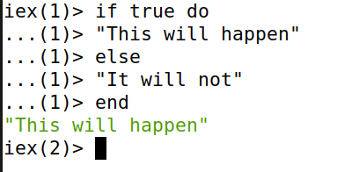
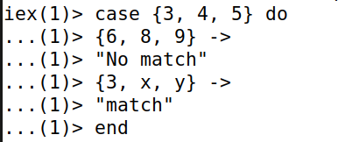
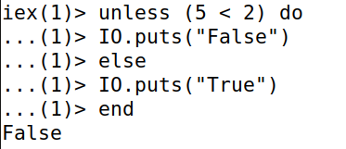
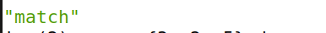
Control Flow
If…else…
When the condition is true, evaluate the expression
Unless
When the condition is false, evaluate the expression
Case
Pattern Matching
Compare the given expression with the given clauses

Slide 17
Immutable Data
Elixir data is immutable meaning once the data is assigned, the data value in memory will not be modified.
Rebinding the value to a new variable does not change the existing memory location
Uses new memory and points to the new location
Benefits:
Side-effect-free functions: makes code predictable, easier to understand and test
Consistent data: expected data in returned
Possess all versions of a data structure
Able to perform in depth operations on the memory

Slide 18
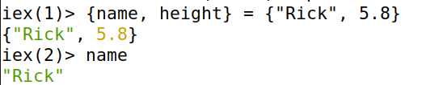

Pattern Matching
‘=’ is not assignment
Match operator
Two parts:
Left side: pattern
Right side: expression

Slide 19
Evaluation of Elixir
Pros:
Syntax
Pattern Matching
Immutable Data
Fault Tolerance
Elixir Shell
BEAM and Erlang Libraries
Cons:
Lack of Individual Libraries
Speed
Smaller Community
Functional

